Slide 1
Walmart Sales Forecasting
June 10, 2024

Slide 2
Agenda
Walmart Sales Forecasting
Analyzing and Predicting Weekly Sales
Data Sources and Description
Data Preprocessing
Store Types Distribution
Sales Distribution
Holiday Impact on Sales
Correlation Matrix
Feature Engineering
Modeling
Evaluation
Visualization
Conclusion
Q&A

Slide 3
Analyzing and Predicting Weekly Sales for Walmart Stores
This presentation delves into the methods and processes used to forecast sales for Walmart stores based on historical data. It highlights the importance of sales forecasting for determining seasonal demands, preventing financial losses, positively influencing stock prices, managing inventories, and planning effective marketing campaigns.

Slide 4
Analyzing and Predicting Weekly Sales
The primary goal of this project is to forecast sales for Walmart stores based on historical data and identify key factors influencing sales. Accurate sales forecasting helps determine seasonal demands, prevent financial losses, positively influence stock prices, manage inventories efficiently, and plan effective marketing campaigns.

Slide 5
Data Sources and Description
Source
Walmart’s historical sales records.
Key Columns
Store: The ID of the store. Date: The week of sales. Weekly_Sales: The sales amount for the week. IsHoliday: Indicates if the week includes a holiday.
Additional Features
Data includes features such as store number, department, date, weekly sales, and other variables.

Slide 6
Data Preprocessing
Merging Datasets
Date Conversion
Using the pd.merge() function in pandas to combine datasets on the 'Store' column.
Converting date strings to datetime objects using pd.to_datetime().
Handling Missing Values
Handling Outliers
Techniques: Filling missing values with mean/median values using fillna(); Dropping rows with missing values using dropna() if the proportion is small; Using interpolation methods where appropriate.
Methods: Identifying outliers using the Interquartile Range (IQR) method; Using Z-score to detect outliers; Treating outliers by capping or using transformation techniques like log transformation.

Slide 7
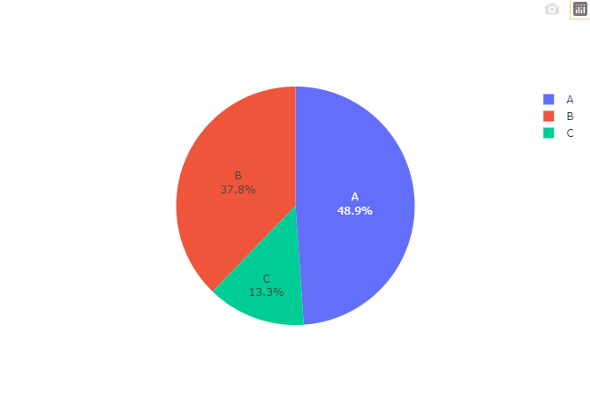
Store Types Distribution
Type A stores are the most numerous among all store types, which helps tailor forecasting models.
The trend that larger stores are more prevalent helps maintain market demand and supply in check.
Distribution of Store Types
Notes:
Types are based on store size
A is the biggest, and so forth
The larger stores are more prevalent as shown by the pie chart

Slide 8
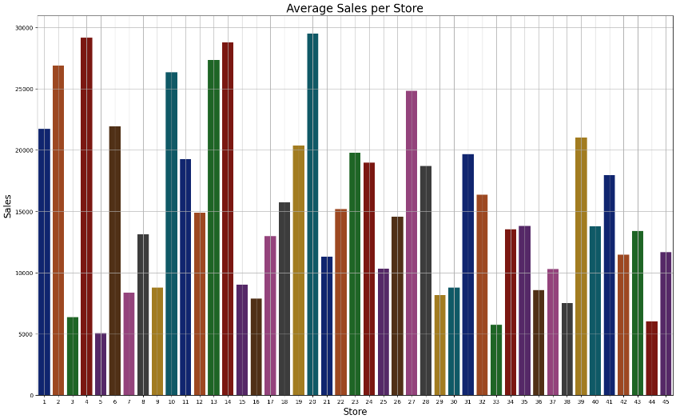
Sales Distribution
Overall Sales
Distribution of weekly sales across different stores and departments.
Provides insight into sales patterns and variability over time.
Key for understanding the performance of stores and departments over time.

Slide 9
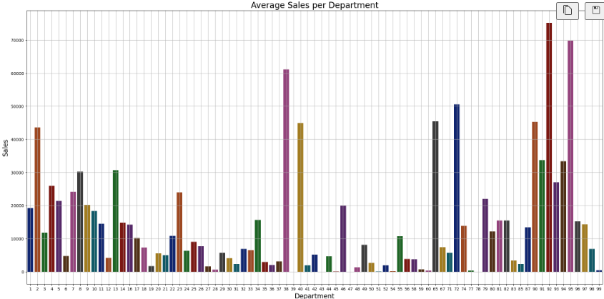
Sales Distribution Cont.
Insight
Helps in identifying high-performing stores and departments.
Useful for tailoring forecasting models.
Supports inventory and marketing strategy adjustments.
Demonstrates the necessity of supply storage during times of High Demand

Slide 10
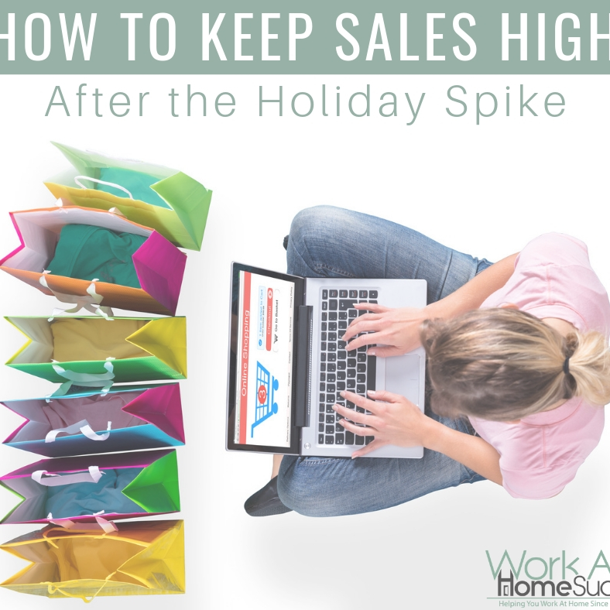
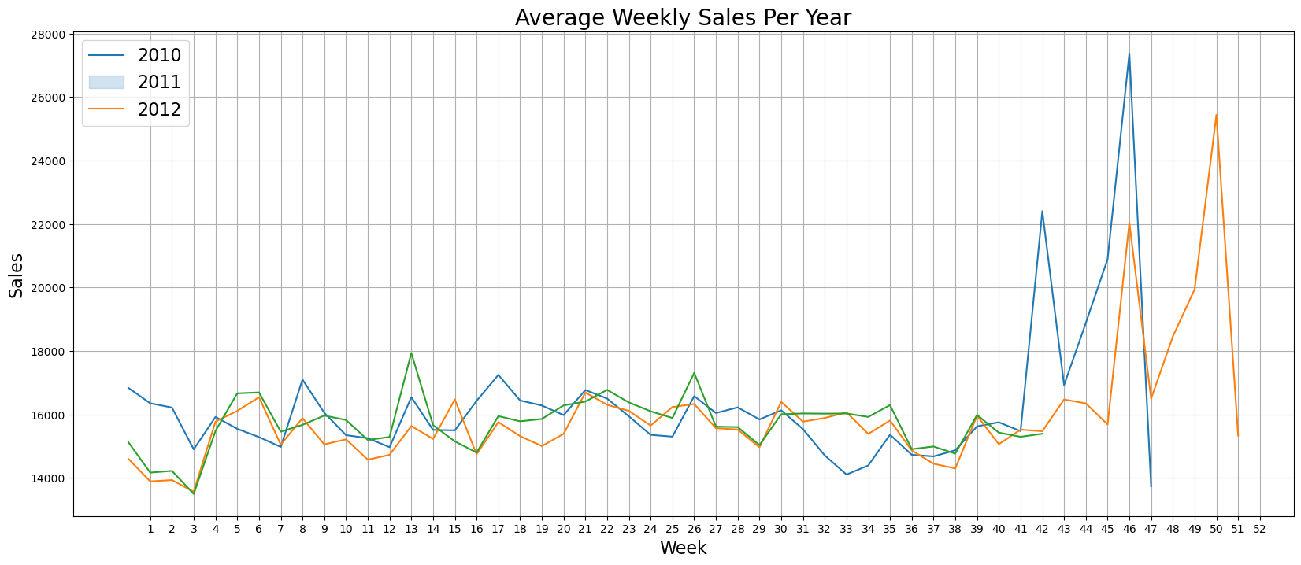
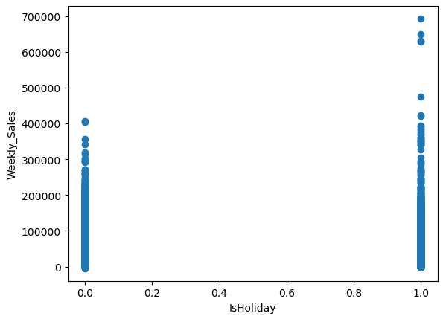
Holiday Impact on Sales
Impact of Holidays on Sales
Historical sales data shows significant spikes during holiday weeks, such as Thanksgiving and Christmas.
Holidays influence consumer behavior, leading to increased spending on gifts, decorations, and holiday-specific items.
Accurately forecasting holiday sales can help Walmart manage inventory and staffing more effectively.

Slide 11
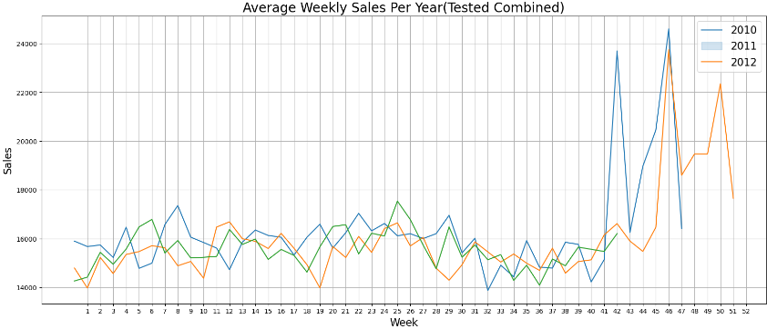
Correlation Matrix
Correlation Analysis
Analyzed relationships between features and weekly sales using a correlation matrix. Key predictors identified are the holidays and far more erratic pathing of election years.
.
Insights
Key relationships: Strong correlations between store types, holidays, and weekly sales.

Slide 12
Feature Engineering
Creating New Features
Aggregate Features
Temporal Features
Feature Selection
Generated new features such as multiple graphs/charts in one cell, multiple line graphs on one chart, as well as learning multiple ways to create different models.
Calculated rolling averages, cumulative sums, etc. These aggregates help in capturing trends over time and improve model accuracy.
Extracted day of the week, month, and holidays. These features help in understanding the temporal patterns in sales data.
Selected important features based on correlation analysis and domain knowledge.

Slide 13
Modeling
Model Selection
Training and Validation
Chose Ridge and Lasso regression models for forecasting.
Split data into training and testing sets. Trained models and validated their performance using cross-validation.
Hyperparameter Tuning
Used GridSearchCV and RandomizedSearchCV for hyperparameter tuning. Optimized parameters for the best model performance.

Slide 14




Evaluation
Model Performance Metrics
Comparison of Models
Evaluated models using metrics such as Mean Squared Error (MSE) and R-squared (R2) score. For example, Ridge MSE: `ridge_mse`, Lasso MSE: `lasso_mse`, Ridge R2: `ridge_r2`, Lasso R2: `lasso_r2`.
Compared the performance of Ridge and Lasso regression models.
Visualizations of Results
Future Improvements
Visualized actual vs predicted sales. For instance, plotting the actual sales against Ridge and Lasso predictions to observe performance.
Build different models for specific stores or departments. Conduct market basket analysis to identify high-demand items in departments.

Slide 15
Conclusion
Summarized key insights from the analysis and modeling.
1
Key factors influencing sale volume: holidays, store types, and department performance. Other factors may include sales, shortages, stormy weather, etc.
2
Best-performing model: Exponential Smoothing with the lowest error.
3
Future work: additional feature engineering, experimenting with other models, and improving markdown effect modeling.
4

Slide 16
View The Code:
We will now go to present our code!

Slide 17
Q&A
Thank you for your attention. Now, we would like to open the floor for any questions or comments you may have regarding our Walmart Sales Forecasting project. Feel free to ask about the data sources, preprocessing steps, modeling techniques, or our findings and future improvements. We are here to discuss and clarify any points.

